Slide 1

Optum Climate Supporters (OCS)
Join us and make sustainable living a priority today!

Slide 2
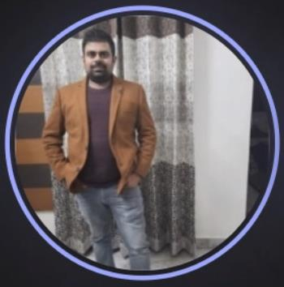
OPTUM CLIMATE SUPPORTERS (OCS)
Poorvi Lashkary
(8800154989)
Anshula Verma
(9871011369)
Vandana Shrestha
(9999405743)
Animesh Garg
(9758180729)
Kanav Narula
(9877202373)

Slide 3
Problem Statement
With growing population and economy, we have increased volumes of waste generated every day.
Unsafe disposal of waste generates dangerous gases and leachates, due to microbial decomposition, climate conditions, refuse characteristics and land-filling operations.
Inadequate waste services leads to unpleasant living conditions and a polluted, unhealthy environment.
Waste must be managed through reuse, recycling, storage, treatment, and effective disposal. It can reduce the amount of pressure we put on our environment and take us closer to sustainable living.
Most recyclable waste ends up in dump yard due to lack of efficient waste management.

Slide 4
Solution
The platform would support the two parties supporting sustainable production with recycled materials:
A Waste Collector who can access the portal to get real time requests for waste collection from nearby places.
A waste material supplier who can access portal to place waste collection request from his/her place by providing available waste details.
Helps suppliers to connect with nearby waste collectors and leads to a hassle-free waste collection process.
Provides reward points for every waste collection request made by suppliers and waste collector which they can redeem with provided offers.
Provided navigation support for waste collector for easy and fast access to supplier’s waste pick up location.
Expanding the network and business opportunities for waste collector by notifying in real time the list of pending waste pickup requests near by.

Slide 5



Salient features:
Simple and user-friendly interface
Empowering both product supplier and waste collector
Enabling seamless waste collection process
Reward points/Eco-friendly redeemable items
Bridging the gap between product users and waste collectors of a particular area
Encouraging recycle and reuse of products to support sustainable living
Product Supplier
Waste collector

Slide 6
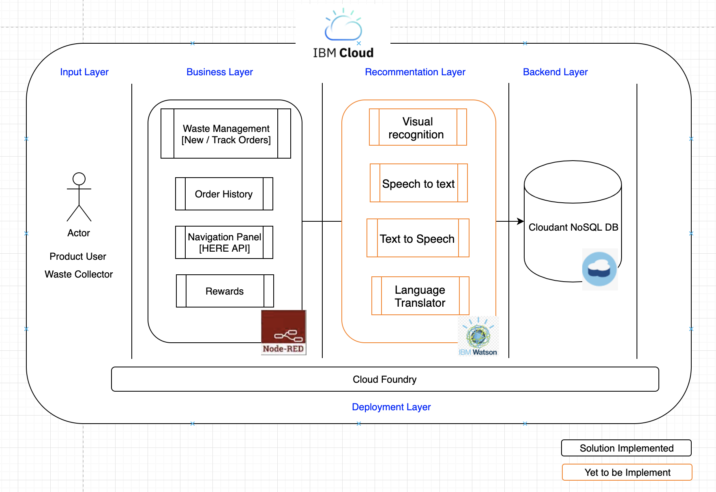
Architecture

Slide 7

Future extension plans – Phase I
Background verification: The portal will have functionality to initiate a background verification on every new registration of waste collector. This is to ensure that waste being collected is properly managed and recycled without impacting the climate and society.
Live navigation feature : Optimizing panel to include text to speech functionality for uninterrupted navigation.
Language translator: Enhancements in the navigation system to support multilingual
instructions in both text and speech.
Data collection usage: The portal will track and send data about the collected waste to an integrated cloud. One can then use this information to identify consumer consumption patterns and determine more eco-friendly product options to the user.

Slide 8

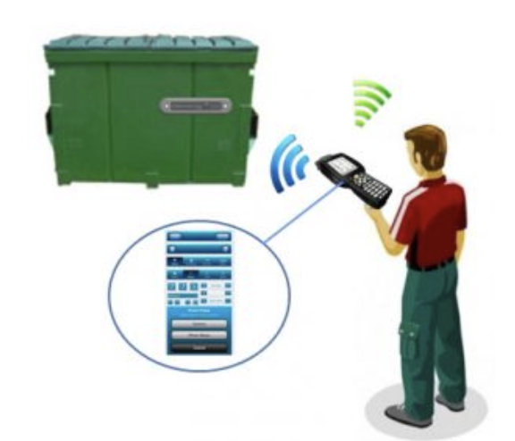
Future extension plans – Phase II
Visual recognition: It automatically identifies the components in the picture uploaded , sorts and tells the waste collector about the various components and its probable usages / value using artificial intelligence. In this manner, we will be able to get the wealth in waste.
RFID usage in waste collection: By using an RFID system, waste can be identified and traced through the entire waste chain. The supplier can be provided with bins with RFID tags. The waste collector will have RFID sensor. In this manner we can collect data about recyclable materials and implement efficient waste management system.

Slide 9
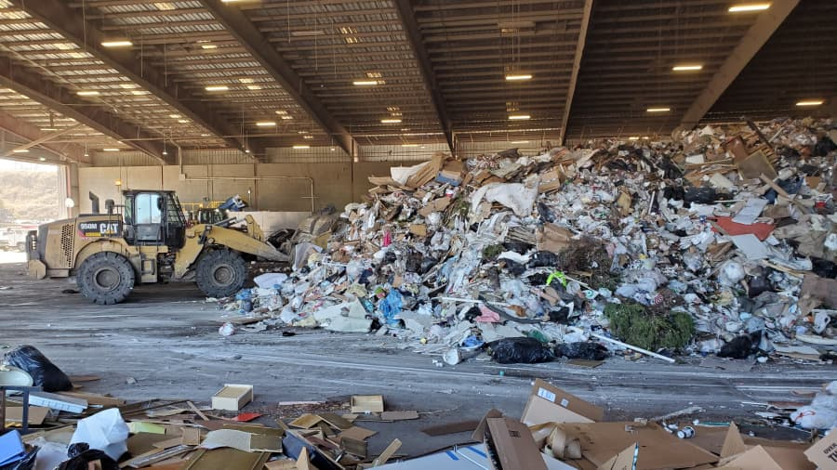

Optum Climate Supporters (OCS)

Slide 10
Demo https://www.youtube.com/watch?v=jn4PY74bJCw

Slide 11
Thank You

